Slide 1
A Neuro-Symbolic Architecture for Safe and Feasible Self-Recovery in Multi-Agent Manufacturing Systems
Jonghan Lim¹, Shih-Jie Shih³, Jiabao Zhao², Evan Watts², Rômulo Meira-Góes³, Ilya Kovalenko^{1,2}
¹ Harold and Inge Marcus Department of Industrial and Manufacturing Engineering
² Department of Mechanical Engineering
³ School of Electrical Engineering and Computer Science
Pennsylvania State University, University Park, 16802, USA

Slide 2
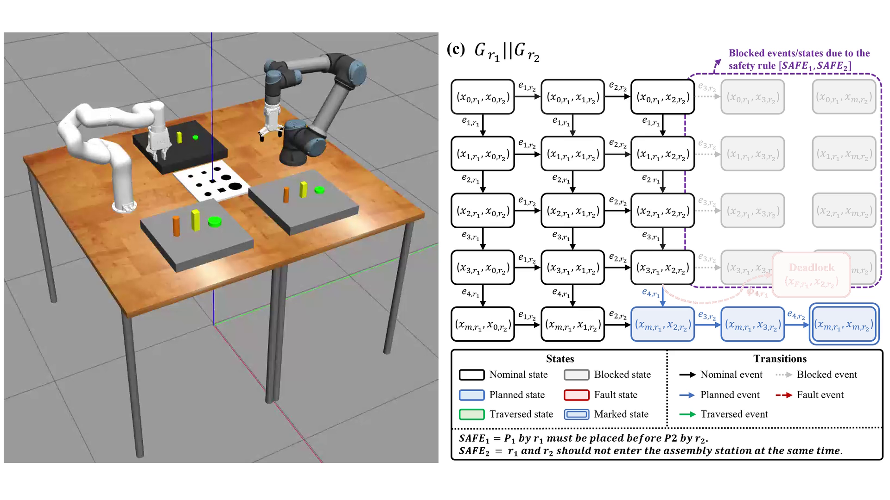
Failure: the gear slips and production deadlocks
Illustrative example · Robot 1 and Robot 2
Robot 1 drops gear P1 during insertion; Robot 2 may not place pin P2 before it: deadlock.
Notes:
Nominal production: Robot 1 places gear P1 and Robot 2 places pin P2 on a shared board. The right panel composes both robots' plans in parallel; green marks traversed states. Safety rules: P1 before P2, and one robot at the board at a time. Robot 2 waits with P2 while Robot 1 inserts P1; P1 slips; Robot 1 is in a fault state and Robot 2 may not place P2 before P1. No nominal event can follow.

Slide 3
How the framework builds a recovery
An illustrative walkthrough, based on the case study's part slippage, a failure of the same kind. Robot 1 drops the gear, and Robot 2 recovers it.
Here, Robot 1 and Robot 2 are two robots of the case-study cell.

Slide 4
Recovery task synthesis
Illustrative walkthrough, based on the part slippage case study
Knowledge base
what can be retrieved
A resource
its recorded values
its state variables
its remaining planned tasks
its named poses, staging areas, processes
where it is: areas, places, workspaces
A part
its recorded values
its state variables
its slot in the finished product
where it is: areas, places, workspaces
Areas and geometry
area bounds
stations, robot bases, floor obstacles
The knowledge base lists what the LLM can retrieve about resources, parts and the cell.
Notes:
The Product Agent's LLM proposes one recovery event per turn. The Resource Agent (RA) checks that it is feasible and the Central Controller Agent (CCA) that it is safe, before it is appended.

Slide 5
Recovery task synthesis
Illustrative walkthrough, based on the part slippage case study
Knowledge base
Product Agent
what can be retrieved
LLM
A resource
proposes the next recovery event
its recorded values
its state variables
e^{R}_{k}
its remaining planned tasks
its named poses, staging areas, processes
asks
where it is: areas, places, workspaces
A part
its recorded values
facts
its state variables
its slot in the finished product
where it is: areas, places, workspaces
Areas and geometry
area bounds
stations, robot bases, floor obstacles
The Product Agent's LLM proposes one recovery event per turn.
Notes:
The Product Agent's LLM proposes one recovery event per turn. The Resource Agent (RA) checks that it is feasible and the Central Controller Agent (CCA) that it is safe, before it is appended.

Slide 6
Recovery task synthesis
Illustrative walkthrough, based on the part slippage case study
Knowledge base
Product Agent
Validation
what can be retrieved
LLM
Resource Agent
A resource
proposes the next recovery event
feasibility
its recorded values
its state variables
e^{R}_{k}
its remaining planned tasks
its named poses, staging areas, processes
asks
where it is: areas, places, workspaces
A part
its recorded values
facts
Central Controller Agent
its state variables
safety
its slot in the finished product
where it is: areas, places, workspaces
Areas and geometry
area bounds
stations, robot bases, floor obstacles
refused: feedback to the LLM
RA checks that each proposal is feasible, CCA that it is safe.
Notes:
The Product Agent's LLM proposes one recovery event per turn. The Resource Agent (RA) checks that it is feasible and the Central Controller Agent (CCA) that it is safe, before it is appended.

Slide 7
Recovery task synthesis
Illustrative walkthrough, based on the part slippage case study
Knowledge base
Product Agent
Validation
Accepted events
what can be retrieved
LLM
Resource Agent
A resource
proposes the next recovery event
feasibility
e^{R}₁
its recorded values
its state variables
e^{R}_{k}
its remaining planned tasks
its named poses, staging areas, processes
asks
e^{R}₂
where it is: areas, places, workspaces
A part
its recorded values
facts
Central Controller Agent
e^{R}₃
its state variables
safety
its slot in the finished product
where it is: areas, places, workspaces
Areas and geometry
e^{R}₄
area bounds
stations, robot bases, floor obstacles
refused: feedback to the LLM
Repeat until the recovery rejoins normal production
Accepted events are appended; the loop repeats until the recovery rejoins normal production.
Notes:
The Product Agent's LLM proposes one recovery event per turn. The Resource Agent (RA) checks that it is feasible and the Central Controller Agent (CCA) that it is safe, before it is appended.

Slide 8
Recovery task synthesis
Illustrative walkthrough, based on the part slippage case study
Knowledge base
Product Agent
Validation
Accepted events
what can be retrieved
LLM
Resource Agent
A resource
proposes the next recovery event
feasibility
e^{R}₁
its recorded values
its state variables
e^{R}_{k}
its remaining planned tasks
its named poses, staging areas, processes
asks
e^{R}₂
where it is: areas, places, workspaces
A part
its recorded values
facts
Central Controller Agent
e^{R}₃
its state variables
safety
its slot in the finished product
where it is: areas, places, workspaces
Areas and geometry
e^{R}₄
area bounds
stations, robot bases, floor obstacles
refused: feedback to the LLM
Repeat until the recovery rejoins normal production
Turn 1 · Before proposing anything, the LLM asks the knowledge base for facts.
Notes:
Dynamic context retrieval: the LLM requests only the facts it needs.

Slide 9
Recovery task synthesis
Illustrative walkthrough, based on the part slippage case study
Knowledge base
Product Agent
Validation
Accepted events
what can be retrieved
LLM
Resource Agent
A resource
proposes the next recovery event
feasibility
e^{R}₁
its recorded values
its state variables
e^{R}_{k}
its remaining planned tasks
its named poses, staging areas, processes
asks
e^{R}₂
where it is: areas, places, workspaces
A part
8 facts requested
its recorded values
facts
Central Controller Agent
e^{R}₃
its state variables
safety
its slot in the finished product
where it is: areas, places, workspaces
Areas and geometry
e^{R}₄
area bounds
stations, robot bases, floor obstacles
refused: feedback to the LLM
Repeat until the recovery rejoins normal production
Turn 1 · 8 facts requested; the rows it asked for light up.
Notes:
Before proposing anything, the LLM requests 8 facts: where the gear lies relative to each robot's workspace, the gear's state and slot, both robots' states, poses, capabilities and remaining tasks.

Slide 10
Recovery task synthesis
Illustrative walkthrough, based on the part slippage case study
Knowledge base
Product Agent
Validation
Accepted events
what can be retrieved
LLM
Resource Agent
A resource
proposes the next recovery event
feasibility
e^{R}₁
its recorded values
its state variables
e^{R}_{k}
its remaining planned tasks
its named poses, staging areas, processes
asks
e^{R}₂
where it is: areas, places, workspaces
A part
its recorded values
facts
Central Controller Agent
e^{R}₃
its state variables
safety
its slot in the finished product
Robot 2
places the square peg on the board
where it is: areas, places, workspaces
Areas and geometry
e^{R}₄
area bounds
stations, robot bases, floor obstacles
refused: feedback to the LLM
Repeat until the recovery rejoins normal production
Turn 2 · Robot 2 still holds the square peg. First proposal: place it on the board.
Notes:
The safety rules are not in the LLM's prompt; only the CCA applies them. The refusal goes back to the LLM as feedback.

Slide 11
Recovery task synthesis
Illustrative walkthrough, based on the part slippage case study
Knowledge base
Product Agent
Validation
Accepted events
what can be retrieved
LLM
Resource Agent
A resource
proposes the next recovery event
feasibility
e^{R}₁
its recorded values
its state variables
e^{R}_{k}
Robot 2
places the square peg on the board
its remaining planned tasks
✓
its named poses, staging areas, processes
asks
e^{R}₂
where it is: areas, places, workspaces
A part
its recorded values
facts
Central Controller Agent
e^{R}₃
its state variables
safety
its slot in the finished product
where it is: areas, places, workspaces
Areas and geometry
e^{R}₄
area bounds
stations, robot bases, floor obstacles
refused: feedback to the LLM
Repeat until the recovery rejoins normal production
RA: feasible.
Notes:
The safety rules are not in the LLM's prompt; only the CCA applies them. The refusal goes back to the LLM as feedback.

Slide 12
Recovery task synthesis
Illustrative walkthrough, based on the part slippage case study
Knowledge base
Product Agent
Validation
Accepted events
what can be retrieved
LLM
Resource Agent
A resource
proposes the next recovery event
feasibility
e^{R}₁
its recorded values
its state variables
e^{R}_{k}
its remaining planned tasks
✓
its named poses, staging areas, processes
asks
e^{R}₂
where it is: areas, places, workspaces
A part
its recorded values
facts
Central Controller Agent
e^{R}₃
its state variables
safety
its slot in the finished product
where it is: areas, places, workspaces
Robot 2
places the square peg on the board
Areas and geometry
✗
e^{R}₄
area bounds
stations, robot bases, floor obstacles
refused: feedback to the LLM
Repeat until the recovery rejoins normal production
CCA refuses: Robot 1 and Robot 2 would both be in the assembly board area.
Notes:
The safety rules are not in the LLM's prompt; only the CCA applies them. The refusal goes back to the LLM as feedback.

Slide 13
Recovery task synthesis
Illustrative walkthrough, based on the part slippage case study
Knowledge base
Product Agent
Validation
Accepted events
what can be retrieved
LLM
Resource Agent
A resource
proposes the next recovery event
feasibility
e^{R}₁
its recorded values
its state variables
e^{R}_{k}
its remaining planned tasks
its named poses, staging areas, processes
asks
e^{R}₂
where it is: areas, places, workspaces
A part
its recorded values
facts
Central Controller Agent
e^{R}₃
its state variables
safety
its slot in the finished product
Robot 2
sets the square peg down in the buffer
where it is: areas, places, workspaces
Areas and geometry
e^{R}₄
area bounds
stations, robot bases, floor obstacles
refused: feedback to the LLM
Repeat until the recovery rejoins normal production
The next candidate in the same turn: set the peg down in the buffer.
Notes:
The LLM proposes alternatives in each turn; the first that passes both checks is accepted.

Slide 14
Recovery task synthesis
Illustrative walkthrough, based on the part slippage case study
Knowledge base
Product Agent
Validation
Accepted events
what can be retrieved
LLM
Resource Agent
A resource
proposes the next recovery event
feasibility
e^{R}₁
its recorded values
its state variables
e^{R}_{k}
Robot 2
sets the square peg down in the buffer
its remaining planned tasks
✓
its named poses, staging areas, processes
asks
e^{R}₂
where it is: areas, places, workspaces
A part
its recorded values
facts
Central Controller Agent
e^{R}₃
its state variables
safety
its slot in the finished product
where it is: areas, places, workspaces
Areas and geometry
e^{R}₄
area bounds
stations, robot bases, floor obstacles
refused: feedback to the LLM
Repeat until the recovery rejoins normal production
RA: feasible.
Notes:
The LLM proposes alternatives in each turn; the first that passes both checks is accepted.

Slide 15
Recovery task synthesis
Illustrative walkthrough, based on the part slippage case study
Knowledge base
Product Agent
Validation
Accepted events
what can be retrieved
LLM
Resource Agent
A resource
proposes the next recovery event
feasibility
e^{R}₁
its recorded values
its state variables
e^{R}_{k}
its remaining planned tasks
✓
its named poses, staging areas, processes
asks
e^{R}₂
where it is: areas, places, workspaces
A part
its recorded values
facts
Central Controller Agent
e^{R}₃
its state variables
safety
its slot in the finished product
where it is: areas, places, workspaces
Robot 2
sets the square peg down in the buffer
Areas and geometry
✓
e^{R}₄
area bounds
stations, robot bases, floor obstacles
refused: feedback to the LLM
Repeat until the recovery rejoins normal production
RA and CCA accept it.
Notes:
The LLM proposes alternatives in each turn; the first that passes both checks is accepted.

Slide 16
Recovery task synthesis
Illustrative walkthrough, based on the part slippage case study
Knowledge base
Product Agent
Validation
Accepted events
what can be retrieved
LLM
Resource Agent
Robot 2
sets the square peg down in the buffer
e^{R}₁
A resource
proposes the next recovery event
feasibility
e^{R}₁
its recorded values
its state variables
e^{R}_{k}
its remaining planned tasks
its named poses, staging areas, processes
asks
e^{R}₂
where it is: areas, places, workspaces
A part
its recorded values
facts
Central Controller Agent
e^{R}₃
its state variables
safety
its slot in the finished product
where it is: areas, places, workspaces
Areas and geometry
e^{R}₄
area bounds
stations, robot bases, floor obstacles
refused: feedback to the LLM
Repeat until the recovery rejoins normal production
Appended as event 1.
Notes:
The LLM proposes alternatives in each turn; the first that passes both checks is accepted.

Slide 17
Recovery task synthesis
Illustrative walkthrough, based on the part slippage case study
Knowledge base
Product Agent
Validation
Accepted events
what can be retrieved
LLM
Resource Agent
Robot 2
sets the square peg down in the buffer
e^{R}₁
A resource
proposes the next recovery event
feasibility
e^{R}₁
its recorded values
its state variables
e^{R}_{k}
its remaining planned tasks
its named poses, staging areas, processes
asks
e^{R}₂
where it is: areas, places, workspaces
A part
its recorded values
facts
Central Controller Agent
e^{R}₃
its state variables
safety
its slot in the finished product
Robot 1
retracts home, clearing the board
where it is: areas, places, workspaces
Areas and geometry
e^{R}₄
area bounds
stations, robot bases, floor obstacles
refused: feedback to the LLM
Repeat until the recovery rejoins normal production
Turn 3 · Robot 1 retracts home, which clears the board area.
Notes:
Robot 1 failed during insertion and still occupies the board area.

Slide 18
Recovery task synthesis
Illustrative walkthrough, based on the part slippage case study
Knowledge base
Product Agent
Validation
Accepted events
what can be retrieved
LLM
Resource Agent
Robot 2
sets the square peg down in the buffer
e^{R}₁
A resource
proposes the next recovery event
feasibility
e^{R}₁
its recorded values
its state variables
e^{R}_{k}
its remaining planned tasks
✓
its named poses, staging areas, processes
asks
e^{R}₂
where it is: areas, places, workspaces
A part
its recorded values
facts
Central Controller Agent
e^{R}₃
its state variables
safety
its slot in the finished product
where it is: areas, places, workspaces
Robot 1
retracts home, clearing the board
Areas and geometry
✓
e^{R}₄
area bounds
stations, robot bases, floor obstacles
refused: feedback to the LLM
Repeat until the recovery rejoins normal production
RA and CCA accept it.
Notes:
Robot 1 failed during insertion and still occupies the board area.

Slide 19
Recovery task synthesis
Illustrative walkthrough, based on the part slippage case study
Knowledge base
Product Agent
Validation
Accepted events
what can be retrieved
LLM
Resource Agent
Robot 2
sets the square peg down in the buffer
e^{R}₁
A resource
proposes the next recovery event
feasibility
e^{R}₁
its recorded values
its state variables
e^{R}_{k}
its remaining planned tasks
Robot 1
retracts home, clearing the board
asks
e^{R}₂
its named poses, staging areas, processes
e^{R}₂
where it is: areas, places, workspaces
A part
its recorded values
facts
Central Controller Agent
e^{R}₃
its state variables
safety
its slot in the finished product
where it is: areas, places, workspaces
Areas and geometry
e^{R}₄
area bounds
stations, robot bases, floor obstacles
refused: feedback to the LLM
Repeat until the recovery rejoins normal production
Appended as event 2.
Notes:
Robot 1 failed during insertion and still occupies the board area.

Slide 20
Recovery task synthesis
Illustrative walkthrough, based on the part slippage case study
Knowledge base
Product Agent
Validation
Accepted events
what can be retrieved
LLM
Resource Agent
Robot 2
sets the square peg down in the buffer
e^{R}₁
A resource
proposes the next recovery event
feasibility
e^{R}₁
its recorded values
its state variables
e^{R}_{k}
its remaining planned tasks
Robot 1
retracts home, clearing the board
asks
e^{R}₂
its named poses, staging areas, processes
e^{R}₂
where it is: areas, places, workspaces
A part
its recorded values
facts
Central Controller Agent
e^{R}₃
its state variables
safety
its slot in the finished product
Robot 1
picks the gear
where it is: areas, places, workspaces
Areas and geometry
e^{R}₄
area bounds
stations, robot bases, floor obstacles
refused: feedback to the LLM
Repeat until the recovery rejoins normal production
Turn 4 · Robot 1 picks the gear.
Notes:
Backward derivation finds grasp_part as the producer of picked and held_part. Forward validation (Eq. 12) then searches for a parameter that works, here a joint configuration of Robot 1 at the gear's measured position, and finds none. This proposal was constructed for illustration; the RA's response is the framework's real output (in the recorded run, turn 4 refused a stated pick position).

Slide 21
Recovery task synthesis
Illustrative walkthrough, based on the part slippage case study
Knowledge base
Product Agent
Validation
Accepted events
what can be retrieved
LLM
Resource Agent
Robot 2
sets the square peg down in the buffer
e^{R}₁
A resource
proposes the next recovery event
feasibility
e^{R}₁
its recorded values
its state variables
e^{R}_{k}
Robot 1
picks the gear
its remaining planned tasks
✗
Robot 1
retracts home, clearing the board
asks
e^{R}₂
its named poses, staging areas, processes
e^{R}₂
where it is: areas, places, workspaces
A part
its recorded values
facts
Central Controller Agent
e^{R}₃
its state variables
safety
its slot in the finished product
where it is: areas, places, workspaces
Areas and geometry
e^{R}₄
area bounds
stations, robot bases, floor obstacles
refused: feedback to the LLM
Repeat until the recovery rejoins normal production
RA does not accept: it finds no arm configuration for Robot 1 at the gear's measured position (Eq. 12).
Notes:
Backward derivation finds grasp_part as the producer of picked and held_part. Forward validation (Eq. 12) then searches for a parameter that works, here a joint configuration of Robot 1 at the gear's measured position, and finds none. This proposal was constructed for illustration; the RA's response is the framework's real output (in the recorded run, turn 4 refused a stated pick position).

Slide 22
Recovery task synthesis
Illustrative walkthrough, based on the part slippage case study
Knowledge base
Product Agent
Validation
Accepted events
what can be retrieved
LLM
Resource Agent
Robot 2
sets the square peg down in the buffer
e^{R}₁
A resource
proposes the next recovery event
feasibility
e^{R}₁
its recorded values
its state variables
e^{R}_{k}
its remaining planned tasks
Robot 1
retracts home, clearing the board
asks
e^{R}₂
its named poses, staging areas, processes
e^{R}₂
where it is: areas, places, workspaces
A part
its recorded values
facts
Central Controller Agent
e^{R}₃
its state variables
safety
its slot in the finished product
Robot 2
picks the gear at its measured position
where it is: areas, places, workspaces
Areas and geometry
e^{R}₄
area bounds
stations, robot bases, floor obstacles
refused: feedback to the LLM
Repeat until the recovery rejoins normal production
Turn 5 · Robot 2, which can reach the gear, picks it at its measured position.
Notes:
The accepted event states only what changes: Robot 2 is picked and holds the gear (grasp_part); the gear is in Robot 2's custody (found by the pick check). Robot 2's Compute pick targets primitive calculates the pick position during composition.

Slide 23
Recovery task synthesis
Illustrative walkthrough, based on the part slippage case study
Knowledge base
Product Agent
Validation
Accepted events
what can be retrieved
LLM
Resource Agent
Robot 2
sets the square peg down in the buffer
e^{R}₁
A resource
proposes the next recovery event
feasibility
e^{R}₁
its recorded values
its state variables
e^{R}_{k}
its remaining planned tasks
✓
Robot 1
retracts home, clearing the board
asks
e^{R}₂
its named poses, staging areas, processes
e^{R}₂
where it is: areas, places, workspaces
A part
its recorded values
facts
Central Controller Agent
e^{R}₃
its state variables
safety
its slot in the finished product
where it is: areas, places, workspaces
Robot 2
picks the gear at its measured position
Areas and geometry
✓
e^{R}₄
area bounds
stations, robot bases, floor obstacles
refused: feedback to the LLM
Repeat until the recovery rejoins normal production
RA and CCA accept it.
Notes:
The accepted event states only what changes: Robot 2 is picked and holds the gear (grasp_part); the gear is in Robot 2's custody (found by the pick check). Robot 2's Compute pick targets primitive calculates the pick position during composition.

Slide 24
Recovery task synthesis
Illustrative walkthrough, based on the part slippage case study
Knowledge base
Product Agent
Validation
Accepted events
what can be retrieved
LLM
Resource Agent
Robot 2
sets the square peg down in the buffer
e^{R}₁
A resource
proposes the next recovery event
feasibility
e^{R}₁
its recorded values
its state variables
e^{R}_{k}
its remaining planned tasks
Robot 1
retracts home, clearing the board
asks
e^{R}₂
its named poses, staging areas, processes
e^{R}₂
where it is: areas, places, workspaces
A part
its recorded values
facts
Central Controller Agent
e^{R}₃
Robot 2
picks the gear at its measured position
e^{R}₃
its state variables
safety
its slot in the finished product
where it is: areas, places, workspaces
Areas and geometry
e^{R}₄
area bounds
stations, robot bases, floor obstacles
refused: feedback to the LLM
Repeat until the recovery rejoins normal production
Appended as event 3.
Notes:
The accepted event states only what changes: Robot 2 is picked and holds the gear (grasp_part); the gear is in Robot 2's custody (found by the pick check). Robot 2's Compute pick targets primitive calculates the pick position during composition.

Slide 25
Recovery task synthesis
Illustrative walkthrough, based on the part slippage case study
Knowledge base
Product Agent
Validation
Accepted events
what can be retrieved
LLM
Resource Agent
Robot 2
sets the square peg down in the buffer
e^{R}₁
A resource
proposes the next recovery event
feasibility
e^{R}₁
its recorded values
its state variables
e^{R}_{k}
its remaining planned tasks
Robot 1
retracts home, clearing the board
asks
e^{R}₂
its named poses, staging areas, processes
e^{R}₂
where it is: areas, places, workspaces
A part
its recorded values
facts
Central Controller Agent
e^{R}₃
Robot 2
picks the gear at its measured position
e^{R}₃
its state variables
safety
its slot in the finished product
Robot 2
places the gear in its slot on the board
where it is: areas, places, workspaces
Areas and geometry
e^{R}₄
area bounds
stations, robot bases, floor obstacles
refused: feedback to the LLM
Repeat until the recovery rejoins normal production
Turn 6 · Robot 2 places the gear in its slot.
Notes:
The gear goes to its slot on the assembly board, Gear_Shaft_1.

Slide 26
Recovery task synthesis
Illustrative walkthrough, based on the part slippage case study
Knowledge base
Product Agent
Validation
Accepted events
what can be retrieved
LLM
Resource Agent
Robot 2
sets the square peg down in the buffer
e^{R}₁
A resource
proposes the next recovery event
feasibility
e^{R}₁
its recorded values
its state variables
e^{R}_{k}
its remaining planned tasks
✓
Robot 1
retracts home, clearing the board
asks
e^{R}₂
its named poses, staging areas, processes
e^{R}₂
where it is: areas, places, workspaces
A part
its recorded values
facts
Central Controller Agent
e^{R}₃
Robot 2
picks the gear at its measured position
e^{R}₃
its state variables
safety
its slot in the finished product
where it is: areas, places, workspaces
Robot 2
places the gear in its slot on the board
Areas and geometry
✓
e^{R}₄
area bounds
stations, robot bases, floor obstacles
refused: feedback to the LLM
Repeat until the recovery rejoins normal production
RA and CCA accept it.
Notes:
The gear goes to its slot on the assembly board, Gear_Shaft_1.

Slide 27
Recovery task synthesis
Illustrative walkthrough, based on the part slippage case study
Knowledge base
Product Agent
Validation
Accepted events
what can be retrieved
LLM
Resource Agent
Robot 2
sets the square peg down in the buffer
e^{R}₁
A resource
proposes the next recovery event
feasibility
e^{R}₁
its recorded values
its state variables
e^{R}_{k}
its remaining planned tasks
Robot 1
retracts home, clearing the board
asks
e^{R}₂
its named poses, staging areas, processes
e^{R}₂
where it is: areas, places, workspaces
A part
its recorded values
facts
Central Controller Agent
e^{R}₃
Robot 2
picks the gear at its measured position
e^{R}₃
its state variables
safety
its slot in the finished product
where it is: areas, places, workspaces
Areas and geometry
e^{R}₄
Robot 2
places the gear in its slot on the board
e^{R}₄
area bounds
stations, robot bases, floor obstacles
refused: feedback to the LLM
Repeat until the recovery rejoins normal production
Appended as event 4.
Notes:
The gear goes to its slot on the assembly board, Gear_Shaft_1.

Slide 28
Recovery task synthesis
Illustrative walkthrough, based on the part slippage case study
Knowledge base
Product Agent
Validation
Accepted events
what can be retrieved
LLM
Resource Agent
Robot 2
sets the square peg down in the buffer
e^{R}₁
A resource
proposes the next recovery event
feasibility
e^{R}₁
its recorded values
its state variables
e^{R}_{k}
its remaining planned tasks
Robot 1
retracts home, clearing the board
asks
e^{R}₂
its named poses, staging areas, processes
e^{R}₂
where it is: areas, places, workspaces
A part
its recorded values
facts
Central Controller Agent
e^{R}₃
Robot 2
picks the gear at its measured position
e^{R}₃
its state variables
safety
its slot in the finished product
LLM
declares the recovery complete
where it is: areas, places, workspaces
Areas and geometry
e^{R}₄
Robot 2
places the gear in its slot on the board
e^{R}₄
area bounds
stations, robot bases, floor obstacles
refused: feedback to the LLM
Repeat until the recovery rejoins normal production
Turn 7 · The LLM declares the recovery complete.
Notes:
The LLM decides when the recovery is complete; the CCA checks the claim.

Slide 29
Recovery task synthesis
Illustrative walkthrough, based on the part slippage case study
Knowledge base
Product Agent
Validation
Accepted events
what can be retrieved
LLM
Resource Agent
Robot 2
sets the square peg down in the buffer
e^{R}₁
A resource
proposes the next recovery event
feasibility
e^{R}₁
its recorded values
its state variables
e^{R}_{k}
its remaining planned tasks
Robot 1
retracts home, clearing the board
asks
e^{R}₂
its named poses, staging areas, processes
e^{R}₂
where it is: areas, places, workspaces
A part
its recorded values
facts
Central Controller Agent
e^{R}₃
Robot 2
picks the gear at its measured position
e^{R}₃
its state variables
nonblocking check
its slot in the finished product
where it is: areas, places, workspaces
LLM
declares the recovery complete
Areas and geometry
✓
e^{R}₄
Robot 2
places the gear in its slot on the board
e^{R}₄
area bounds
stations, robot bases, floor obstacles
refused: feedback to the LLM
Repeat until the recovery rejoins normal production
CCA checks that normal production can finish from this state: it can. Synthesis complete.
Notes:
The nonblocking check (Eq. 6) explores the plant from the projected state and finds that every remaining nominal task can still complete.

Slide 30
Primitive composition
Illustrative walkthrough, based on the part slippage case study
Knowledge base
Resource Agent · Robot 2
LLM writes the program
what can be retrieved
e^{R}₃
Robot 2
picks the gear at its measured position
The robot
its recorded values
its state at the start of this event
its current tool pose
asks
Program of Robot 2's primitives
the part it holds
the places it reaches
its route around its base
its event model
facts
Its primitives
the primitive catalogue
what each primitive needs and does
how its nominal tasks use primitives
A part
its recorded values
its last measured pose
its destination
Feasibility check
schema · parameters · preconditions · postconditions · motion planning
Also
the active event
area bounds
station and robot geometry
The Resource Agent (RA) turns each accepted event into a program of the robot's own primitives.
Notes:
Here event 3: Robot 2 picks the gear at its measured position. The feasibility check covers the program's schema, parameters, preconditions, postconditions and motion planning.

Slide 31
Primitive composition
Illustrative walkthrough, based on the part slippage case study
Knowledge base
Resource Agent · Robot 2
LLM writes the program
what can be retrieved
e^{R}₃
Robot 2
picks the gear at its measured position
The robot
its recorded values
its state at the start of this event
its current tool pose
asks
Program of Robot 2's primitives
the part it holds
the places it reaches
its route around its base
its event model
facts
Its primitives
the primitive catalogue
what each primitive needs and does
how its nominal tasks use primitives
A part
its recorded values
its last measured pose
its destination
Feasibility check
schema · parameters · preconditions · postconditions · motion planning
Also
the active event
area bounds
station and robot geometry
Turn 1 · The LLM asks the knowledge base for the facts it needs.
Notes:
Dynamic context retrieval for composition.

Slide 32
Primitive composition
Illustrative walkthrough, based on the part slippage case study
Knowledge base
Resource Agent · Robot 2
LLM writes the program
what can be retrieved
e^{R}₃
Robot 2
picks the gear at its measured position
Turn 1 · 14 facts requested
The robot
its recorded values
its state at the start of this event
its current tool pose
asks
Program of Robot 2's primitives
the part it holds
the places it reaches
its route around its base
its event model
facts
Its primitives
the primitive catalogue
what each primitive needs and does
how its nominal tasks use primitives
A part
its recorded values
its last measured pose
its destination
Feasibility check
schema · parameters · preconditions · postconditions · motion planning
Also
the active event
area bounds
station and robot geometry
Turn 1 · 14 facts requested: primitive contracts, task decompositions, robot and part state.
Notes:
Rows light up for the facts the LLM requested in this run.

Slide 33
Primitive composition
Illustrative walkthrough, based on the part slippage case study
Knowledge base
Resource Agent · Robot 2
LLM writes the program
what can be retrieved
e^{R}₃
Robot 2
picks the gear at its measured position
The robot
its recorded values
its state at the start of this event
its current tool pose
asks
Program of Robot 2's primitives
Turn 2
the part it holds
Move to named pose
Compute pick targets
Move Cartesian
Move Cartesian
the places it reaches
its route around its base
its event model
facts
pose: home
part: small gear
approach pose
target pose
Its primitives
the primitive catalogue
what each primitive needs and does
Grasp part
Move Cartesian
how its nominal tasks use primitives
A part
small gear
retreat pose
its recorded values
its last measured pose
its destination
Feasibility check
schema · parameters · preconditions · postconditions · motion planning
Also
the active event
area bounds
station and robot geometry
Turn 2 · Robot 2 is at the buffer. The LLM's program first moves it straight to its home pose.
Notes:
The nominal pick starts from home, so the LLM begins with a move to the named pose "home".

Slide 34
Primitive composition
Illustrative walkthrough, based on the part slippage case study
Knowledge base
Resource Agent · Robot 2
LLM writes the program
what can be retrieved
Top view of Robot 2
e^{R}₃
Robot 2
picks the gear at its measured position
The robot
its recorded values
its state at the start of this event
base
its current tool pose
asks
Program of Robot 2's primitives
Turn 2
buffer
the part it holds
Move to named pose
Compute pick targets
Move Cartesian
Move Cartesian
gear
the places it reaches
✗
its route around its base
its event model
facts
pose: home
part: small gear
approach pose
target pose
home
Its primitives
the primitive catalogue
what each primitive needs and does
Grasp part
Move Cartesian
no joint angles reach here
how its nominal tasks use primitives
— straight move: no joint solution 0.136 m from the axis
A part
small gear
retreat pose
its recorded values
its last measured pose
its destination
Feasibility check
schema · parameters · preconditions · postconditions · motion planning
✗
Also
the active event
area bounds
station and robot geometry
RA refuses: motion planning must find joint angles for Robot 2's six joints at every point of the move. The straight path from the buffer to home passes 0.136 m from Robot 2's own axis, where no set of joint angles can place the tool, so planning stops 30% of the way.
Notes:
For every point along a planned move, motion planning solves inverse kinematics: it looks for the six joint angles that put the tool there. A UR5e's wrist is offset 0.133 m from its shoulder line, so the tool cannot pass through a narrow cylinder around the base's vertical axis; no joint angles exist there. The straight move from the buffer, tool at (-0.32, 0.50) m, to home, (0.40, 0.20) m, cuts past the base at (0.00, 0.50); at 30% of the way the tool is 0.136 m from the axis and the solver finds no angles, so the path stops. This is a reach limit of the arm, not a collision. The revised program follows Robot 2's declared route around the base, where joint angles exist at every point.

Slide 35
Primitive composition
Illustrative walkthrough, based on the part slippage case study
Knowledge base
Resource Agent · Robot 2
LLM writes the program
what can be retrieved
Top view of Robot 2
e^{R}₃
Robot 2
picks the gear at its measured position
Turn 3 · 3 more facts requested
The robot
its recorded values
its state at the start of this event
base
its current tool pose
asks
Program of Robot 2's primitives
Turn 2
buffer
the part it holds
Move to named pose
Compute pick targets
Move Cartesian
Move Cartesian
gear
the places it reaches
✗
its route around its base
its event model
facts
pose: home
part: small gear
approach pose
target pose
home
Its primitives
the primitive catalogue
what each primitive needs and does
Grasp part
Move Cartesian
no joint angles reach here
how its nominal tasks use primitives
— straight move: no joint solution 0.136 m from the axis
A part
small gear
retreat pose
its recorded values
its last measured pose
its destination
Feasibility check
schema · parameters · preconditions · postconditions · motion planning
Also
the active event
area bounds
station and robot geometry
Turn 3 · The LLM asks for Robot 2's route around its base, the station geometry and its event model.
Notes:
The refusal goes back to the LLM, which looks up the declared route around the base.

Slide 36
Primitive composition
Illustrative walkthrough, based on the part slippage case study
Knowledge base
Resource Agent · Robot 2
LLM writes the program
what can be retrieved
Top view of Robot 2
e^{R}₃
Robot 2
picks the gear at its measured position
The robot
its recorded values
its state at the start of this event
base
its current tool pose
asks
Program of Robot 2's primitives
Turn 3
buffer
the part it holds
Move Cartesian
Move Cartesian
Move Cartesian
Compute pick targets
gear
the places it reaches
✗
its route around its base
its event model
facts
to (-0.400, 0.150, 1.501) m
to (0.000, 0.050, 1.501) m
to (0.400, 0.150, 1.501) m
part: small gear
home
Its primitives
the primitive catalogue
what each primitive needs and does
Move Cartesian
Move Cartesian
Grasp part
Move Cartesian
no joint angles reach here
how its nominal tasks use primitives
— straight move: no joint solution 0.136 m from the axis
A part
to (0.250, 0.450, 1.303) m
to (0.250, 0.450, 1.253) m
small gear
to (0.250, 0.450, 1.303) m
— route around the base
its recorded values
its last measured pose
its destination
Feasibility check
schema · parameters · preconditions · postconditions · motion planning
Also
the active event
area bounds
station and robot geometry
The revised program goes around the base through three waypoints instead of moving straight, then picks the gear.
Notes:
The numbers are the resolved targets RA checked: the route at z 1.501 m, the approach at 1.303 m, the pick at 1.253 m.

Slide 37
Primitive composition
Illustrative walkthrough, based on the part slippage case study
Knowledge base
Resource Agent · Robot 2
LLM writes the program
what can be retrieved
Top view of Robot 2
e^{R}₃
Robot 2
picks the gear at its measured position
The robot
its recorded values
its state at the start of this event
base
its current tool pose
asks
Program of Robot 2's primitives
Turn 3
buffer
the part it holds
Move Cartesian
Move Cartesian
Move Cartesian
Compute pick targets
gear
the places it reaches
its route around its base
its event model
facts
to (-0.400, 0.150, 1.501) m
to (0.000, 0.050, 1.501) m
to (0.400, 0.150, 1.501) m
part: small gear
home
Its primitives
the primitive catalogue
what each primitive needs and does
Move Cartesian
Move Cartesian
Grasp part
Move Cartesian
no joint angles reach here
how its nominal tasks use primitives
A part
to (0.250, 0.450, 1.303) m
to (0.250, 0.450, 1.253) m
small gear
to (0.250, 0.450, 1.303) m
— route around the base
its recorded values
its last measured pose
its destination
Feasibility check
schema · parameters · preconditions · postconditions · motion planning
✓
Also
the active event
area bounds
station and robot geometry
RA checks the program, including motion planning: accepted. Every accepted event is composed the same way.
Notes:
All four events are composed into Robot 1's and Robot 2's own primitives.

Slide 38
Back to the illustrative example
Its recovery, executed in Gazebo in parallel with the nominal tasks.

Slide 39
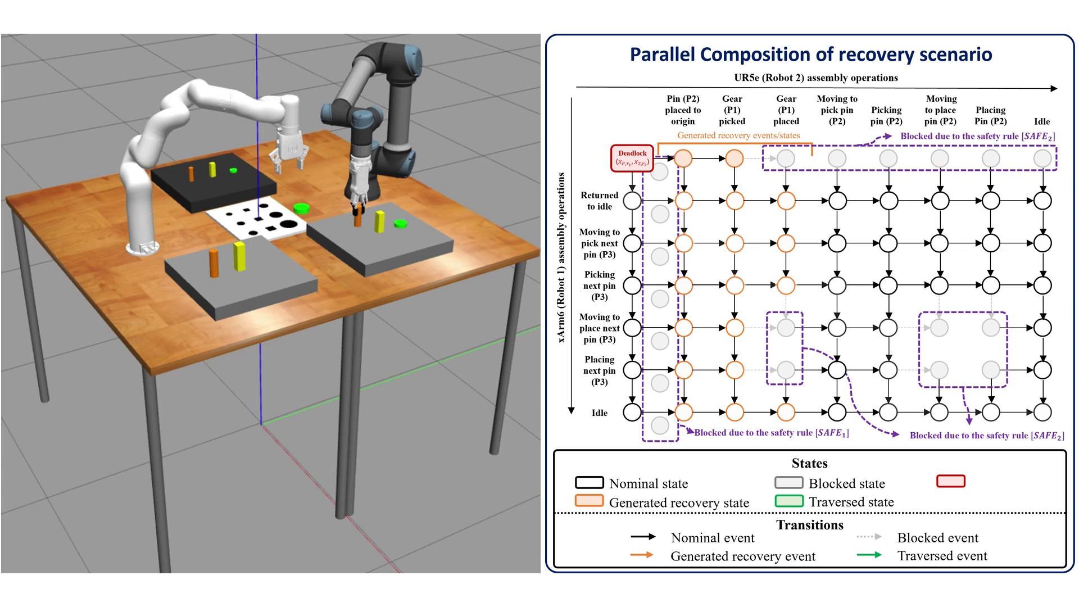
Recovery composed in parallel with the nominal tasks
Illustrative example · Robot 1 and Robot 2 · Gazebo
Recovery events (orange) and nominal tasks run concurrently; the green path is the run.
Notes:
Robot 2's operations run left to right, Robot 1's top to bottom. Robot 1 returns to idle and Robot 2 sets pin P2 aside; Robot 2 picks up the slipped gear while Robot 1 already resumes its nominal tasks with pin P3; gear P1 is placed first, as the safety rule requires; grey states are blocked by the safety rules. The recovery rejoins the nominal plan and both robots finish.

Slide 40
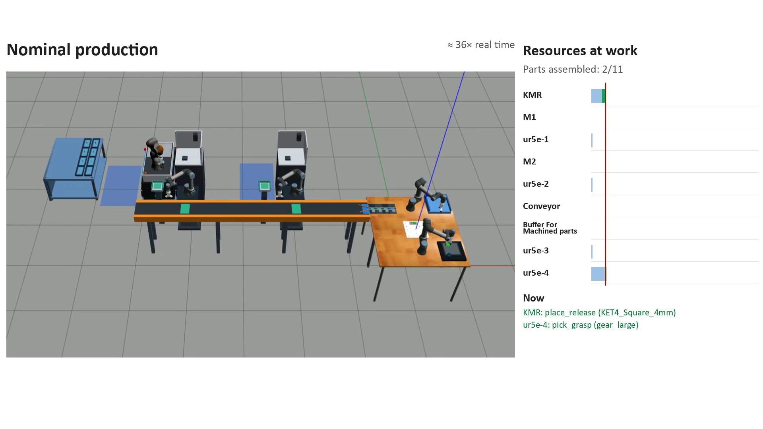
Case study: the manufacturing cell
Nominal production in Gazebo
Four robot arms, two trimming machines (M1, M2), a conveyor and a mobile robot (KMR).
Notes:
The cell builds the product from 11 parts. The panel shows each resource's activity and the parts assembled.

Slide 41
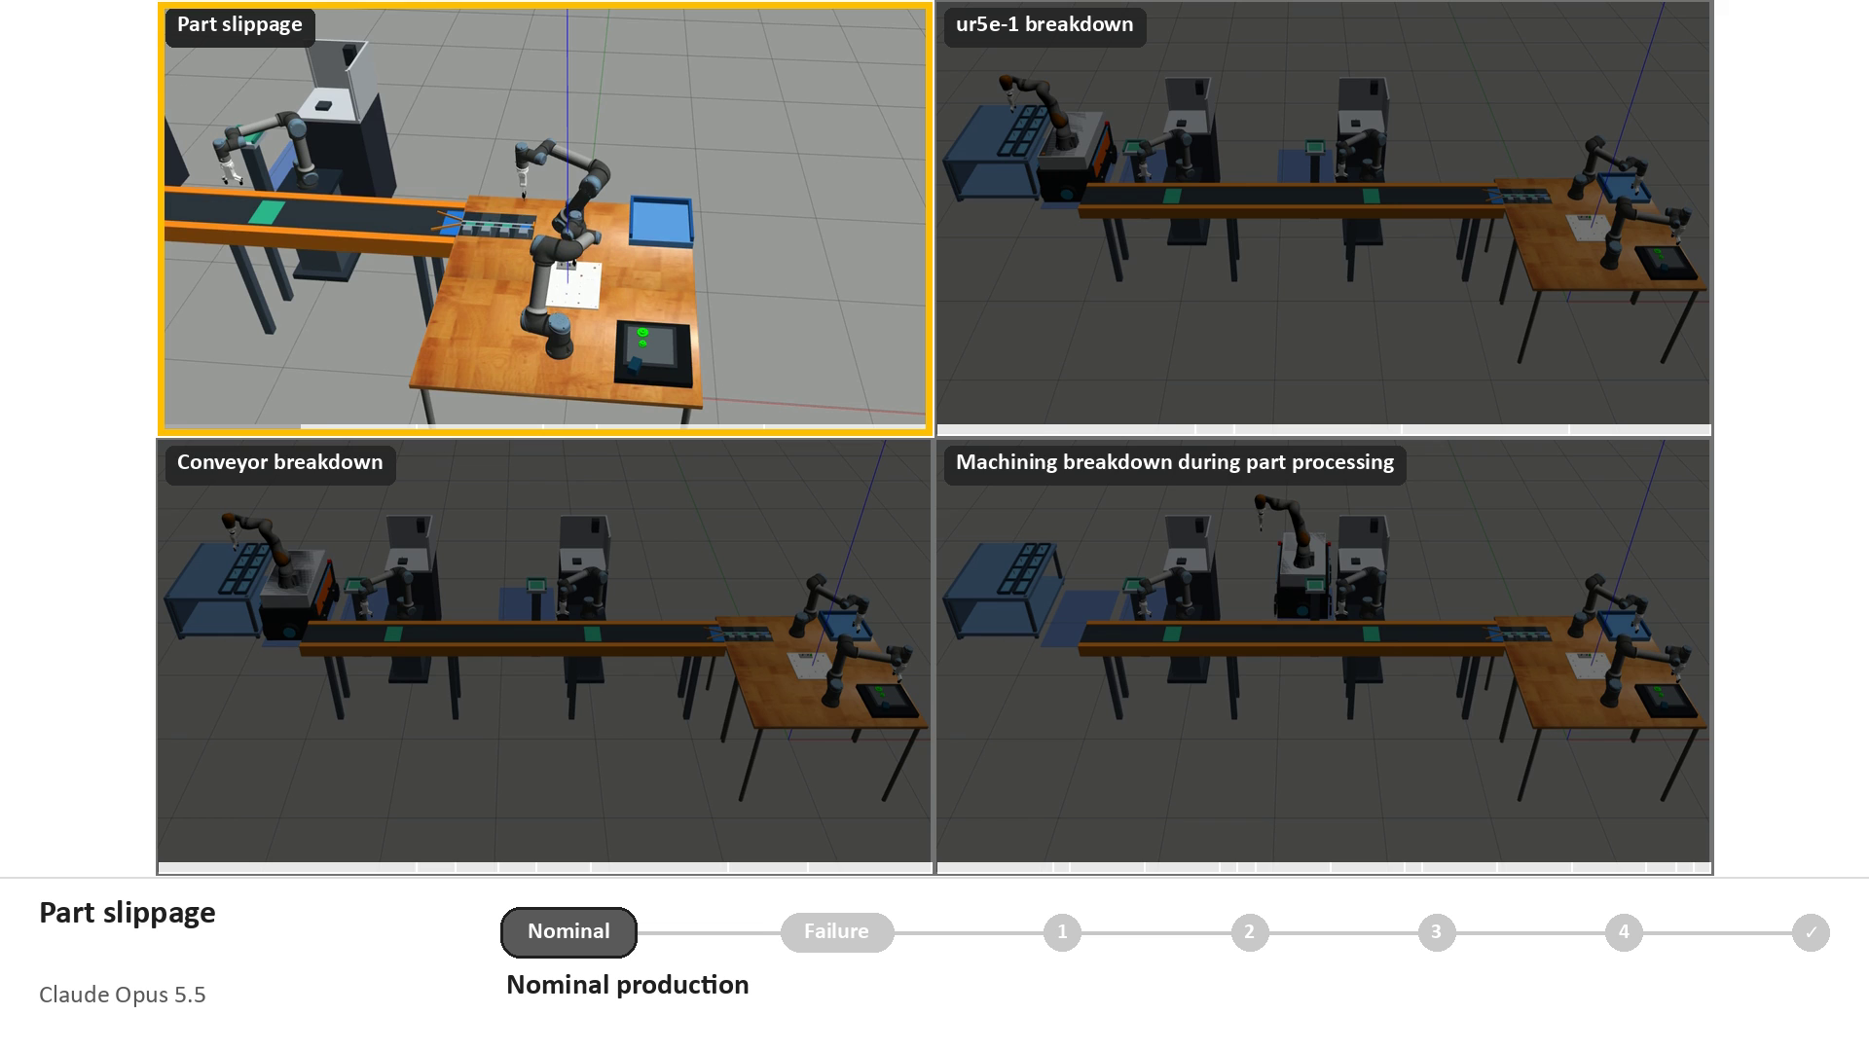
Four failure scenarios
Each recovery proposed by an LLM, checked by RA and CCA, composed and executed in Gazebo
Part slippage · ur5e-1 breakdown · Conveyor breakdown · Machining breakdown
Notes:
Part slippage (Claude Opus 5.5, 4 events); ur5e-1 breakdown (GPT-6.1 Sol, 4 events): the KMR carries the square peg from M1 to the conveyor; Conveyor breakdown (Claude Opus 5.5, 7 events): the KMR carries the trimmed peg to the buffer; Machining breakdown (GPT-6.1 Sol, 14 events): M2 pauses its round peg, trims the square peg, then resumes.

Slide 42
Thank you
A Neuro-Symbolic Architecture for Safe and Feasible Self-Recovery in Multi-Agent Manufacturing Systems
Jonghan Lim, Shih-Jie Shih, Jiabao Zhao, Evan Watts, Rômulo Meira-Góes, Ilya Kovalenko
Pennsylvania State University, University Park, 16802, USA
Contact: Jonghan Lim, jxl567@psu.edu

